Slide 1
CNENGR506 Intelligent Systems Control

Slide 2

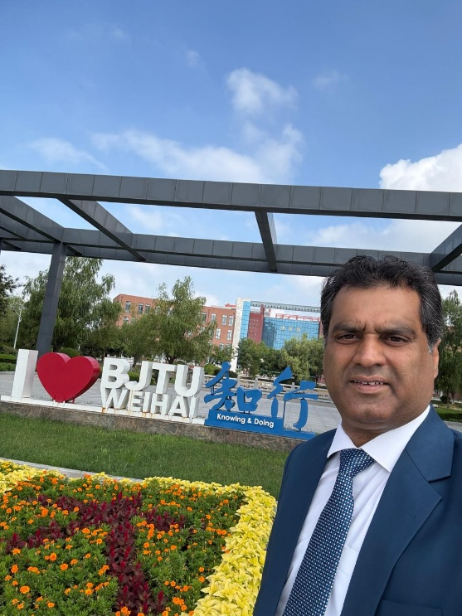
Module Convenor @ BJTU
PhD in Engineering
(Massey University New Zealand-2014)
Master in Engineering Project Management
(University of Auckland, New Zealand, 2023)
Bachelor & Master in Electrical Engineering
(UET Taxila-2000, UET Lahore-2007, Pakistan)
More than 20 Years in Academia
Dr. Muhammad Abrar
(Dr. MAB)
Research (Communication, UAVs, Sustainability, Smart Grid, Interdisciplinary research)

Slide 3
Educational Aims
Introduction to modern algorithmic, computer-aided control system design methods.
Advanced concepts such as digital and optimal control are introduced using algebra and block diagrams.
Addresses the needs of students who would like to advance their knowledge of automatic control, optimisation and data analysis.
Practical worked-examples from robotics, industrial control, environmental systems, among other areas.

Slide 4
Prerequisites
Worked examples cover the fundamentals, hence “control theory” is not a pre-requisite for this module
Students taking this module are expected to be able to:
manipulate algebraic expressions and equations;
manipulate vectors and matrices e.g. knowing how to multiply a column vector and a matrix by hand;
manipulate complex numbers and expressions;
use the MATLAB software environment, including the basics of plotting graphs and writing scripts.

Slide 5
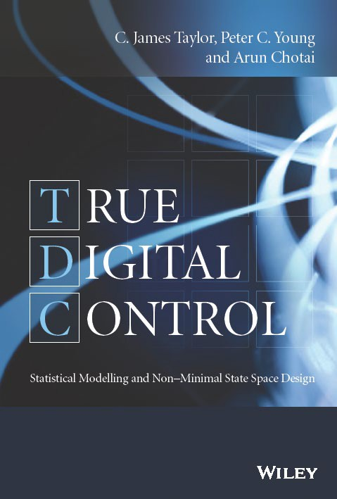
Recommended Book
True Digital Control: Statistical Modelling and Non–Minimal State Space Design (Wiley, 2013).
Optional reading but this is the book that most closely aligns with the taught module.
Some chapters cover more advanced topics beyond the scope of the module.

Slide 6
Module Structure
Lectures: Tuesday (10:10-12:00)
Week 02-03,05-10 (Building 1 C104)
Lab work: Tuesday ( 16:20-18:10)
Week 02-03,05-10 (SX603)
Tutorial: Thursday ( 10:10-12:200)
Week 02-03,05-10 (Building 1 C104)

Slide 7
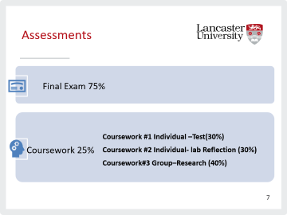
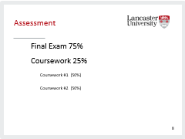
Assessments
Final Exam 75%
Coursework 25%
Coursework #1 Individual –Test(30%)
Coursework #2 Individual- lab Reflection (30%)
Coursework#3 Group–Research (40%)

Slide 8
Coursework #1
Class Test-Moodle
Week 6/7

Slide 9
Coursework #2
1000 words individual submission reflecting on the 4 Lab work sessions, identifying what you have learnt from the Lab work and will take forward into engineering practice.
Hand in date:
Week 10

Slide 10
Coursework #3
Research report
Group coursework consists of a reflection on your chosen research topic related to the module and a presentation.
Presentation will be conducted in Week 9/10.
Submission: week 11

Slide 11
Lab work
Mixture of paper-based exercises and MATLAB computer software-based exercises:
Lab 1
Discrete-Time Transfer Functions and Data-Based Modelling
Lab 2
Data-Based Modelling using MATLAB/SIMULINK
Lab 3
Discrete-Time Control System Design using SIMULINK
Lab 4
Discrete-Time Control System Design

Slide 12
Course Syllabus Motivation
There are many approaches for control system design!
This module focuses on state space methods, using Proportional–Integral–Plus or PIP control as a fully worked example
structure looks similar to PI/PID
state variable feedback design but does not require the Kalman Filter, hence is relatively straightforward to learn
Later, we will use PIP methods to introduce a few other generic concepts, such as optimal and adaptive control

Slide 13
Conclusions
This section has introduced the timetable and organisation of the module.

Slide 14

Thank you, any questions?

